Slide 1
MSBA 605 Python for Analytics
Dr. Madan Mohan Rayguru

Slide 2
I am
From Bhubaneswar, India
PhD in Robotics & Control from IIT Delhi. MSBA from COB, UofL
Assistant Professor in COB and Affiliated Faculty in Louisville Autonomous Robotics Research Institute
Previously worked in Singapore University and Delhi University
Passionate about AI, Human-Machine Coexistence
My research: https://scholar.google.co.in/citations?user=BA2izN0AAAAJ&hl=en

Slide 3

Computer
Dumb device.
Only does what it is told.
So dumb, that it only understands extremely explicit instructions.
We must use a special language: Programming Language.
Programming Language – Language in which a programmer can explain to the computer what he/she needs it to do.

Slide 4
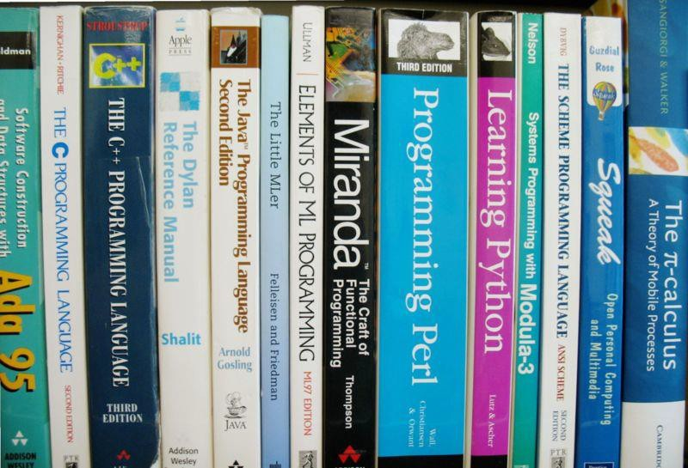
Programming Language
Computers are complex networks of switches.
Only understand sequences of 0’s and 1’s, where 0 represents the off state of the switch and 1 represents the on state of the switch.
Long patterns of 0’s and 1’s represent instructions and data.
This is a very complicated way of communicating with the
computer.
A programmer might spend hours programming the machine using 0’s and 1’s to perform something as simple as adding two numbers.

Slide 5
Programming Language
As systems became more complex, so have the means of communicating with them.
Flipping switches evolved into pointing with the mouse and clicking.
Programming evolved from entering long patterns of 0’s and 1’s using toggle switches, to writing what needs to be done in an “English-Like” language.

Slide 6
Creating a Computer Program
A program is similar to a recipe in a cook book ~ a step-by-step set of instructions for the computer to follow.
A program is written in a programming language.
So how exactly do we do that?

Slide 7
Natural VS. Programming Language
Programming languages are like spoken languages.
They have syntax, semantics, vocabularies, and grammars.
Programming languages are developed by people for a specific purpose.
They are more like professional jargons.

Slide 8
Why Python?
Data Science
ML, DL
Web Dev
AI
Automation
Robotics
Stat.
Web Scrapping

Slide 9
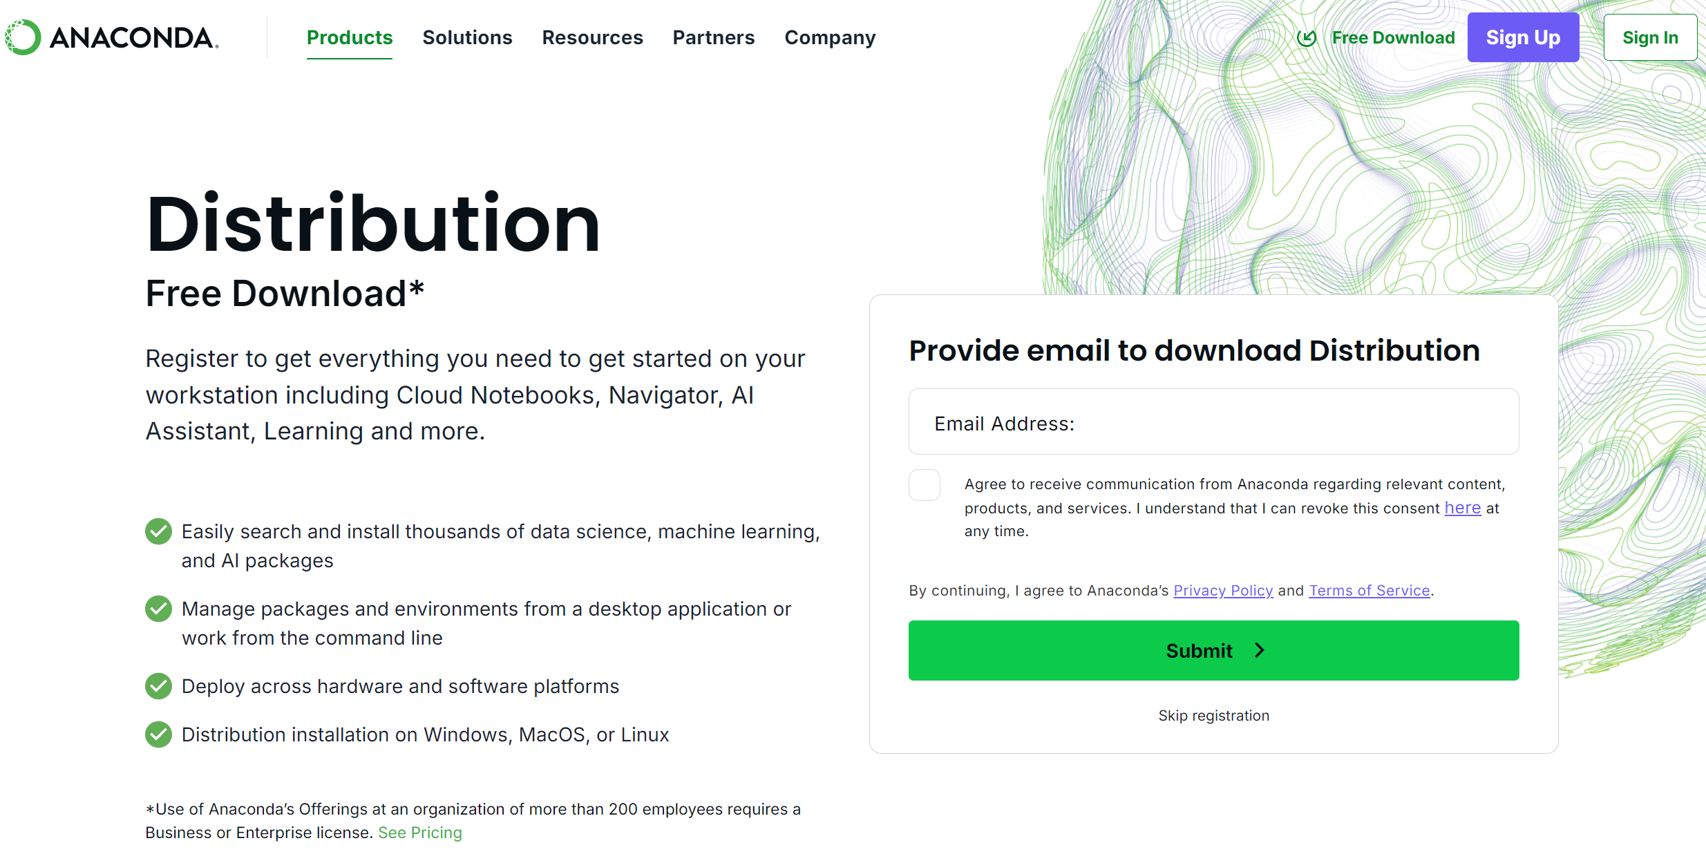

Slide 10
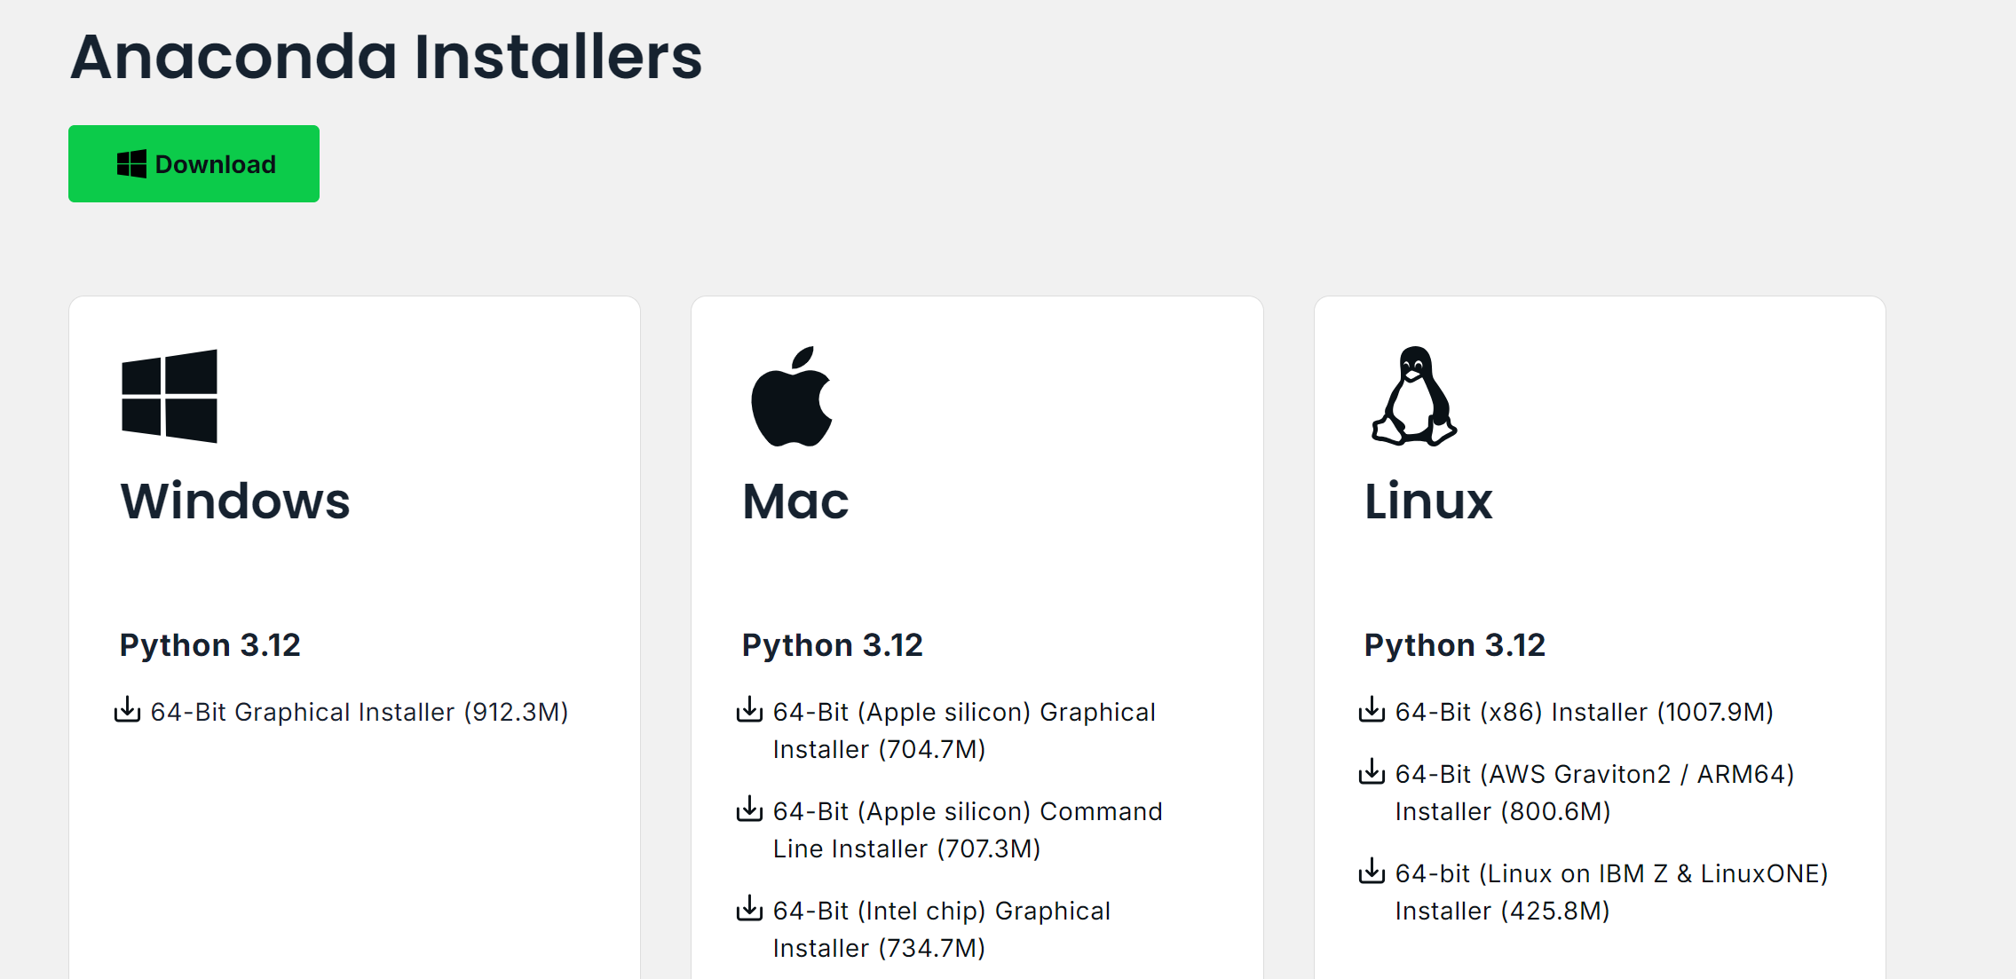

Slide 11
Double-click the .exe/.pkg file you downloaded.
Click Next to begin installation.Accept the license agreement.
Choose Just Me (recommended).
Keep the default install location.
Leave the options as default (do not check “Add Anaconda to PATH”).
Click Install and wait until it finishes.

Slide 12
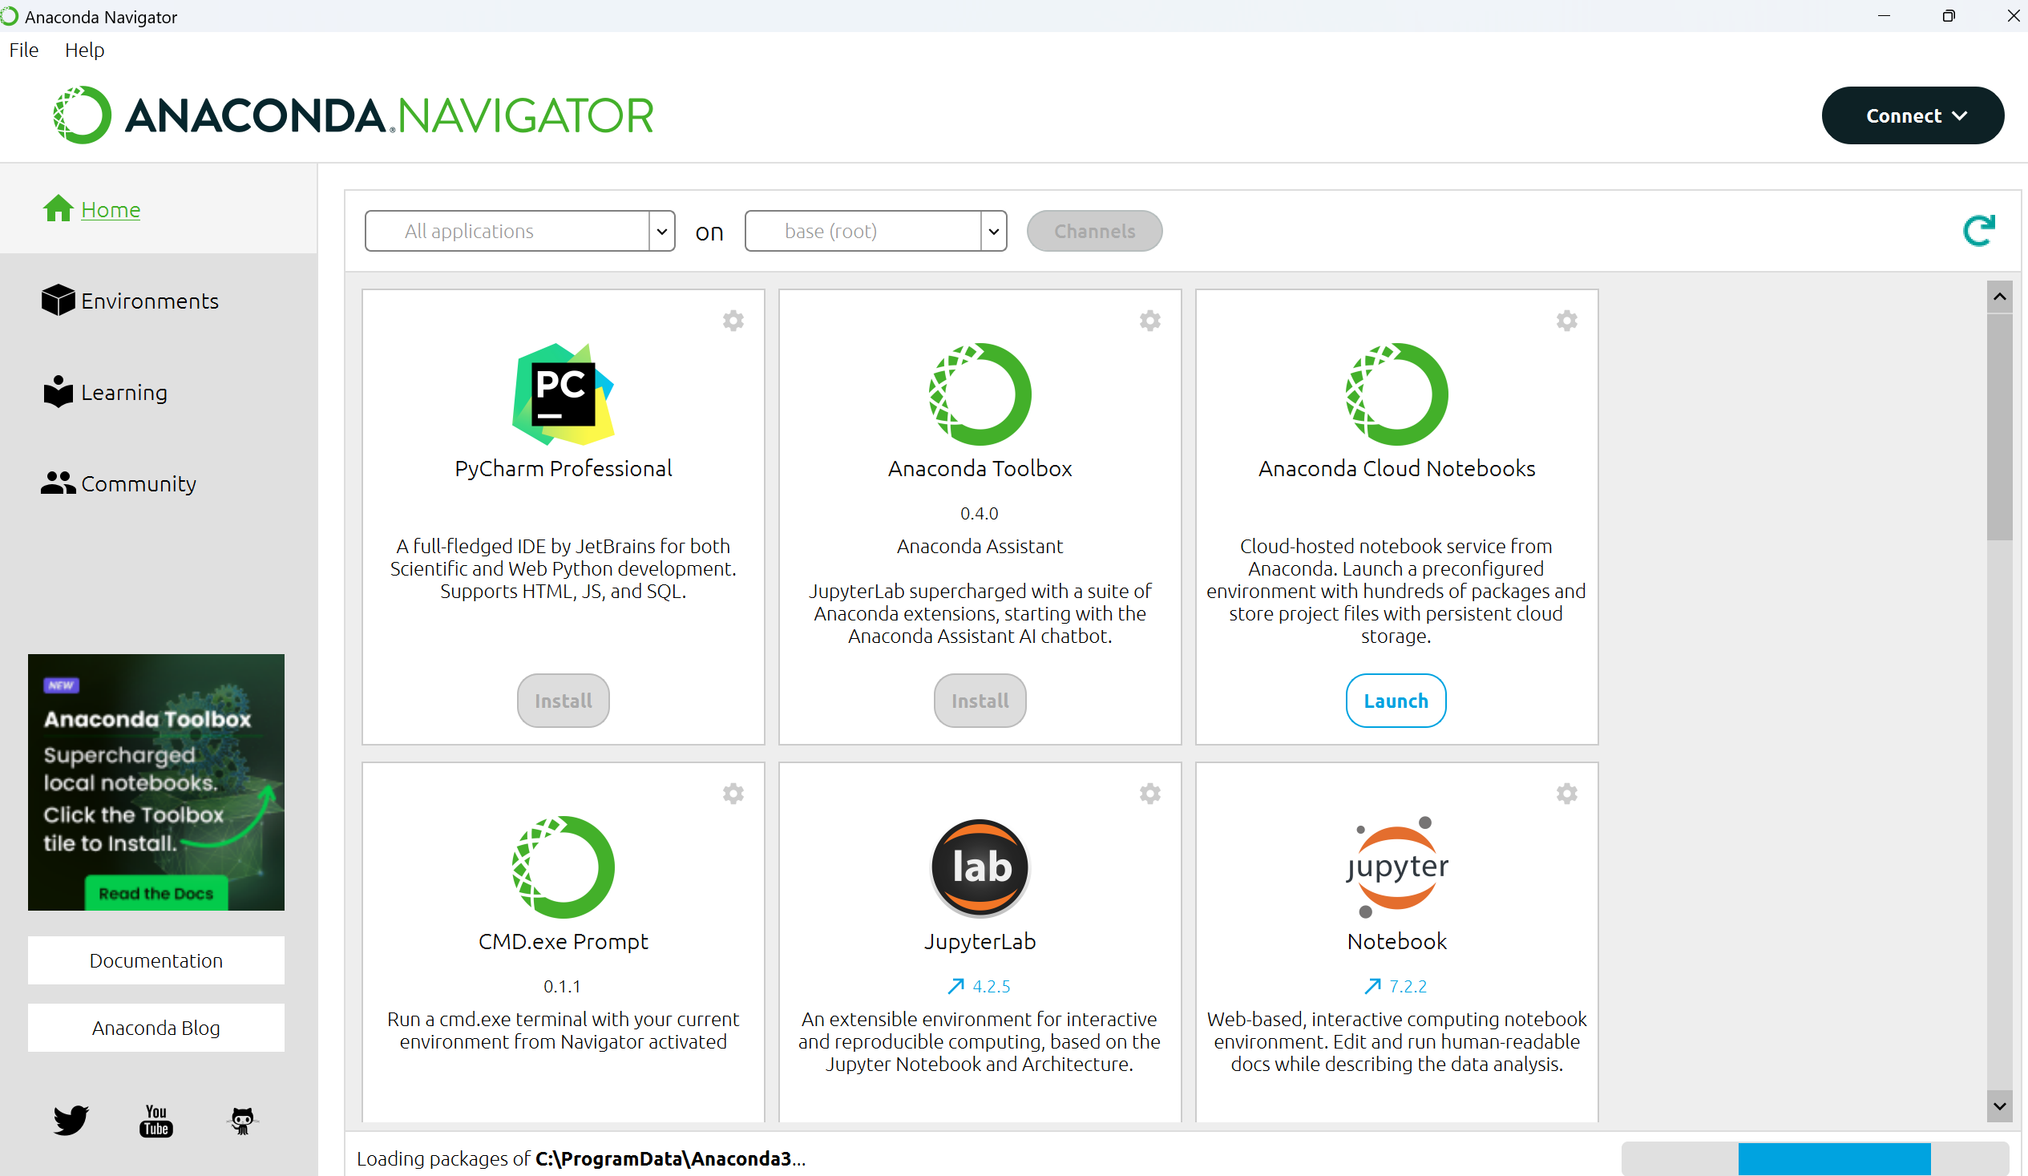

Slide 13
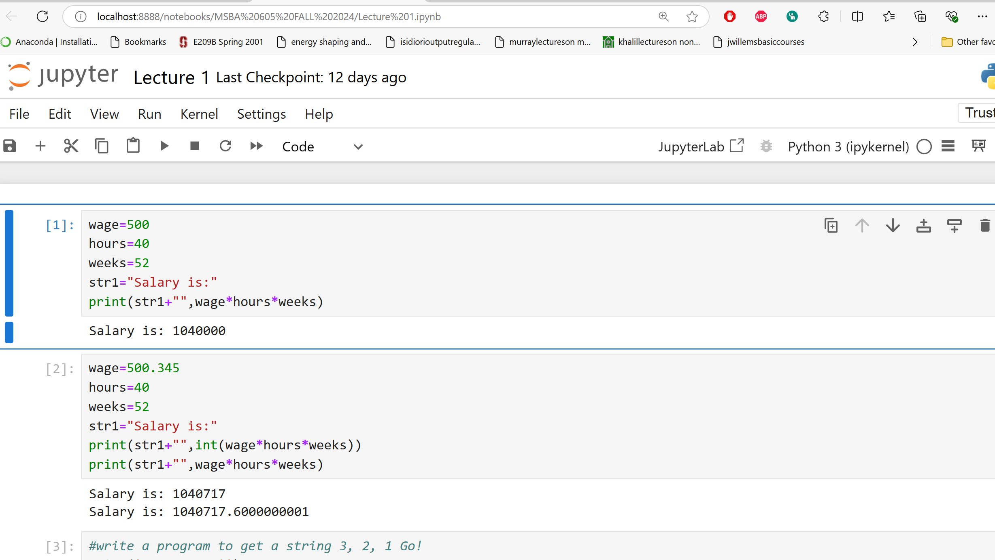

Slide 14
